Slide 1
Applied Physics
Unit 4: LASERS AND FIBER OPTICS
Dr. G. Patrick

Slide 2
Lasers: Introduction, Characteristics of lasers, Einstein coefficients, Resonating cavity, Active medium-Meta stable state, Pumping, Population inversion, Construction and working of Ruby laser and He-Ne laser, Applications of lasers.
Fiber Optics: Introduction, Principle and Structure of an optical fiber, Basic components in optical fiber communication system, Comparison of optical fibers over conventional cables, Acceptance angle-Numerical aperture, Types of optical fibers, Losses associated with optical fibers, Applications of optical fibers.

Slide 3
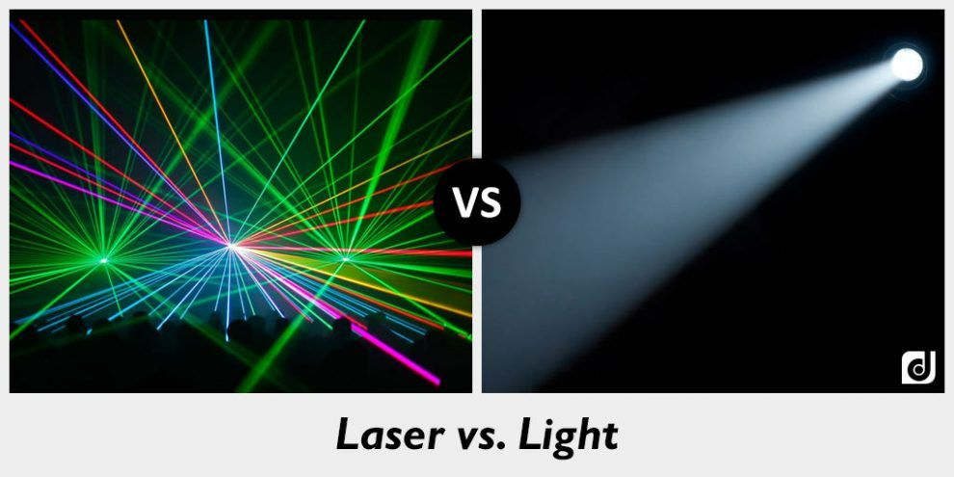
Laser (Light Amplification by Stimulated Emission of Radiation)

Slide 4
Ordinary light and Laser light
Ordinary Light
Laser Light
Spontaneous emission
Incoherent
Divergent
Polychromatic
Cannot be focused to a sharp focus
Stimulated emission
Coherent
Highly directional
Monochromatic
Can be focused to a very sharp spot

Slide 5
LASER: Characteristics
Some of the special properties which distinguish lasers from ordinary light sources are characterized by:
1. Directionality
2. High Intensity
3. Mono- chromaticity
4. Coherent

Slide 6
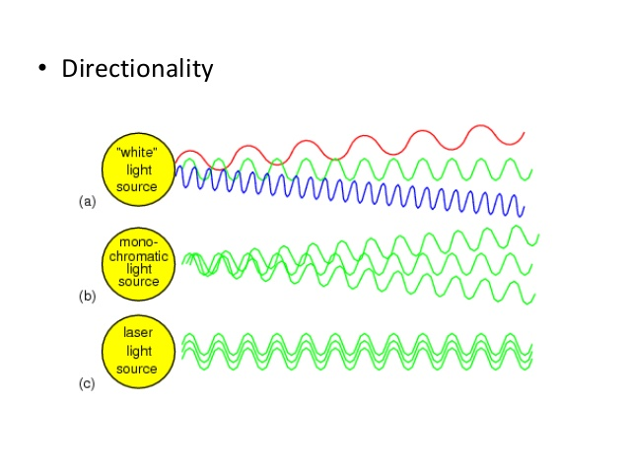
LASER: Characteristics

Slide 7
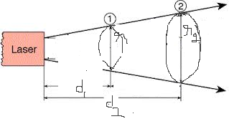
LASER: Characteristics
Directionality
A very tight beam which is very strong and concentrated
The directionality of laser beam is expressed in terms of angle of divergence (ᶲ)

Slide 8
LASER: Characteristics
Divergence or Angular Spread is given by ᶲ = r₂-r₁/d₂-d₁
Where d₁, d₂ are any two distances from the laser source and r₁, r₂ are the radii of beam spots at distance d₁ and d₂ respectively as shown in the figure.
Laser light has less divergence, which means that laser light has more directionality.

Slide 9
LASER: Characteristics
High Intensity
In case of lasers, light is a narrow beam and its energy is concentrated within the small region.
The concentration of energy accounts for greater intensity of lasers.

Slide 10
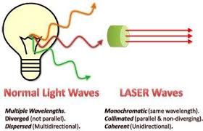
LASER: Characteristics
Mono- chromaticity: one specific colour

Slide 11
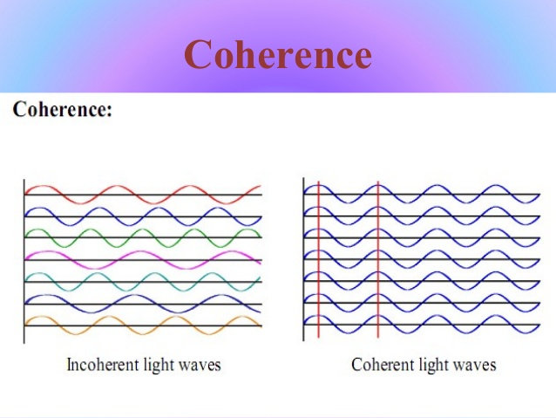
LASER: Characteristics
Coherent

Slide 12
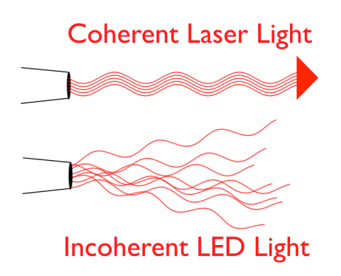
LASER: Characteristics

Slide 13
LASER: Characteristics
Coherence
If any wave appears as pure sine wave for longtime and infinite space, then it is said to be perfectly coherent.
Practically, no wave is perfectly coherent including lasers. But compared to other light sources, lasers have high degree of coherence because all the energy is concentrated within the small region. There are two independent concepts of coherence.
i) Temporal coherence (criteria of time)
ii) Spatial coherence (criteria of space)

Slide 14
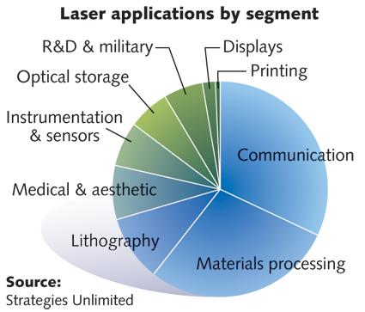
Applications of Laser

Slide 15
Applications of Laser
Communication:
Lasers are used in optical communications, due to large band width.
The laser beam can be used for the communication between earth & moon (or) other satellites due to the narrow angular spread.
Used to establish communication between submarines i.e. under water communication.
Medical:
For removal of Cataract.
Used to detect and remove stones in kidneys.
Used to detect tumors in brain.

Slide 16
Applications of Laser
Industry:
Welding
Cutting
Drilling

Slide 17
Einstein’s Coefficients
In a collection of atoms, all three transition processes occur simultaneously:
Transitions:
Absorption or Stimulated absorption(upward transition)
Spontaneous emission (downward transition)
Stimulated emission (downward transition)

Slide 18
Einstein’s Coefficients
Let
N₁ = number of atoms per unit volume with energy E_{1.}
N₂ = number of atoms per unit volume with energy E_{2.}
u(ט) = energy density of interacting photons.
When these photons interact with atoms both upward(absorption) and downward (stimulated emission) transition occur.

Slide 19
Einstein’s Coefficients
Upward transition
Stimulated absorption rate = N₁ u(ט) B₁₂
Where B₁₂ is the Einstein coefficient of stimulated absorption.
Downward transition
The excited atoms may come down either by spontaneous emission or stimulated emission.

Slide 20
Einstein’s Coefficients
Downward transition
By spontaneous emission
Spontaneous emission rate = N₂ A₂₁
Where A₂₁ is the Einstein coefficient for spontaneous emission.
By Stimulated emission
Stimulated emission rate = N₂ u(ט) B₂₁
Where B₂₁ is the Einstein coefficient for Stimulated emission

Slide 21
Einstein’s Coefficients
Under thermal equilibrium number of upward transitions = number of downward transitions per unit volume per second.
N₂ A₂₁ + N₂ u(ט) B₂₁ = N₁ u(ט) B₁₂ 🠆 1
u(ט) = A₂₁N₂ / B₁₂N₁ - B₂₁N_{2 ----------------> 2}
Dividing all terms by B₂₁N₂ ,
u(ט) = (A₂₁/ B₂₁) x 1 /[ (B₁₂N₁ / B₂₁N₂) – 1 ] --------> 3
By substituting N₁/N₂ = exp (hʋ/kT) from Boltzmann Distribution law,
u(ט) = (A₂₁/ B₂₁) x1/[( B₁₂ / B₂₁) exp (hʋ/kT) – 1] -----> 4

Slide 22
Einstein’s Coefficients
Above equation must agree with planks energy distribution – radiation formula.
u(ט) = 8 π hʋ³/C³ [1/exp (hʋ/kT) -1] ----> 5
Comparing equations 4 & 5
B₁₂ = B₂₁ and get A₂₁/ B₂₁ = 8 π hʋ³/C³
The co-efficients A₂₁, B₁₂ and B₂₁ are known as Einstein coefficients.

Slide 23
Requirements for Laser action/Components of Laser
Population inversion
Metastable state
Active medium
Resonating cavity
Pumping

Slide 24
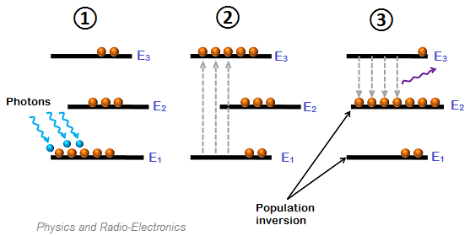
Population inversion

Slide 25
Population inversion
Assume there are a group of N atoms, each of which is capable of being in one of the two energy states.
Let
N₁ = no of atoms in the state E₁
N₂ = no of atoms in the excited state E₂
E₂ > E₁ and N = N₀ exp (-hʋ/kT)
where N₀ is the number of atoms in the ground state.

Slide 26
Population inversion
Under thermal equilibrium condition
N₁ >> N₂ and Population inversion is not achieved.
Population inversion is a condition in which
N₂ >> N₁
This is a non equilibrium state and exists only for a short time.
Population inversion can be achieved by pumping techniques, which transfers large number of atoms from lower energy state to higher energy state.

Slide 27
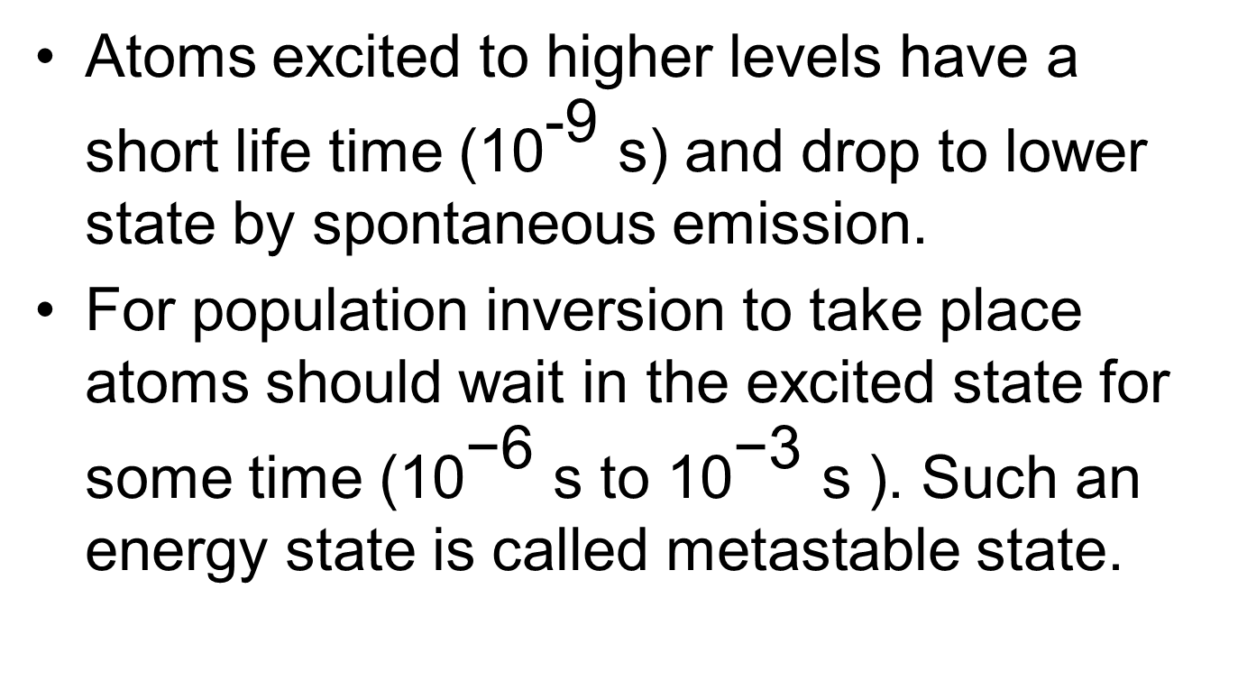
Metastable state

Slide 28
Active medium
Active medium is the material in which laser action takes place.
It is a medium in which population inversion has been achieved.

Slide 29
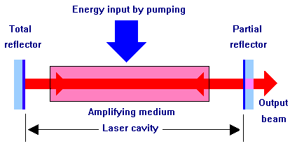
Resonating cavity
A pair of optically plane parallel mirrors, enclosing laser medium in between them is known as optical resonant cavity.
One mirror is fully reflecting and the other partially reflecting.

Slide 30
Role of optical resonator
To provide positive feedback of photons into the medium so that stimulated emission is sustained and the laser acts as a generator of light.
It selects the direction in which light is to be amplified i.e. in the direction of optical axis of the mirror. Optical cavity makes the laser beam directional.
It increases photon density through multiple reflections.
It selects and amplifies only certain frequencies causing laser output to be monochromatic.

Slide 31
Pumping
Pumping is the process of supplying energy to laser system to achieve population inversion.
Methods of pumping
Optical pumping
Electrical discharge

Slide 32
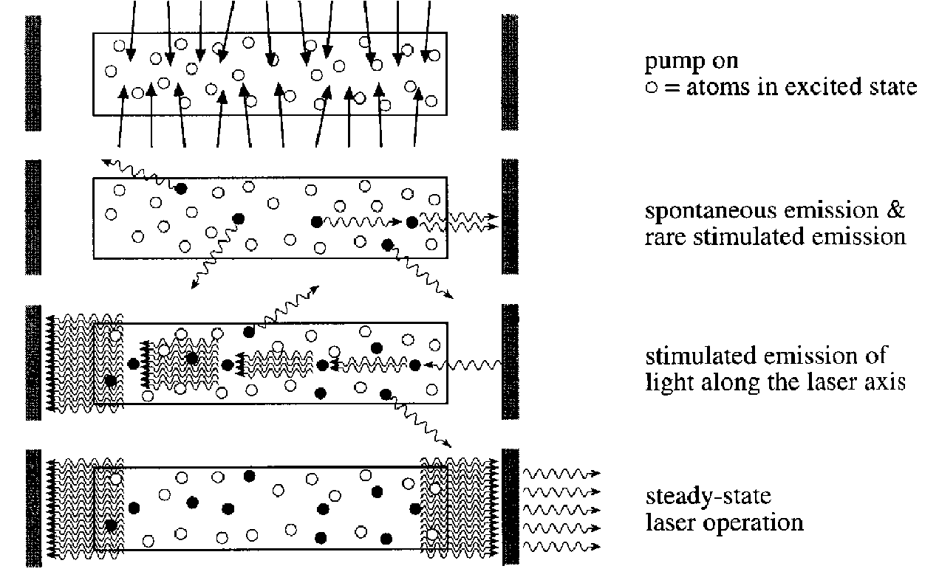
How a Laser Works

Slide 33
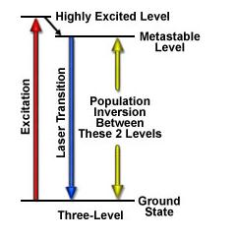

Three-level Laser System
Initially excited to a short-lived high-energy state .
Then quickly decay to the intermediate metastable level.
Population inversion is created between lower ground state and a higher-energy metastable state.

Slide 34
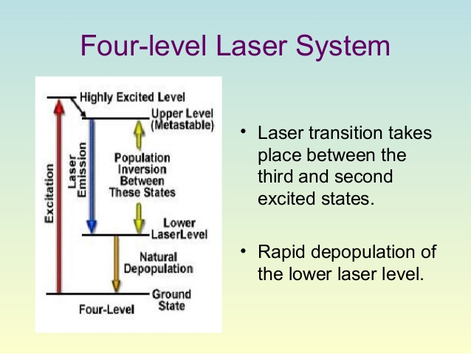
Four level Laser system

Slide 35
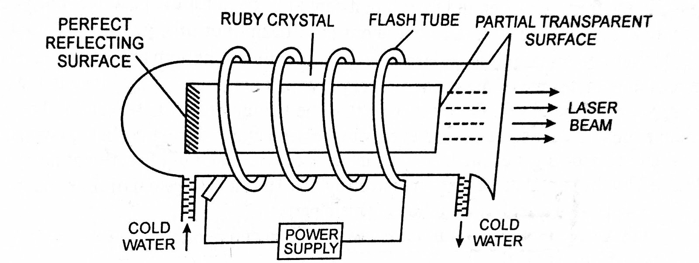
Solid-state Laser : Ruby laser

Slide 36
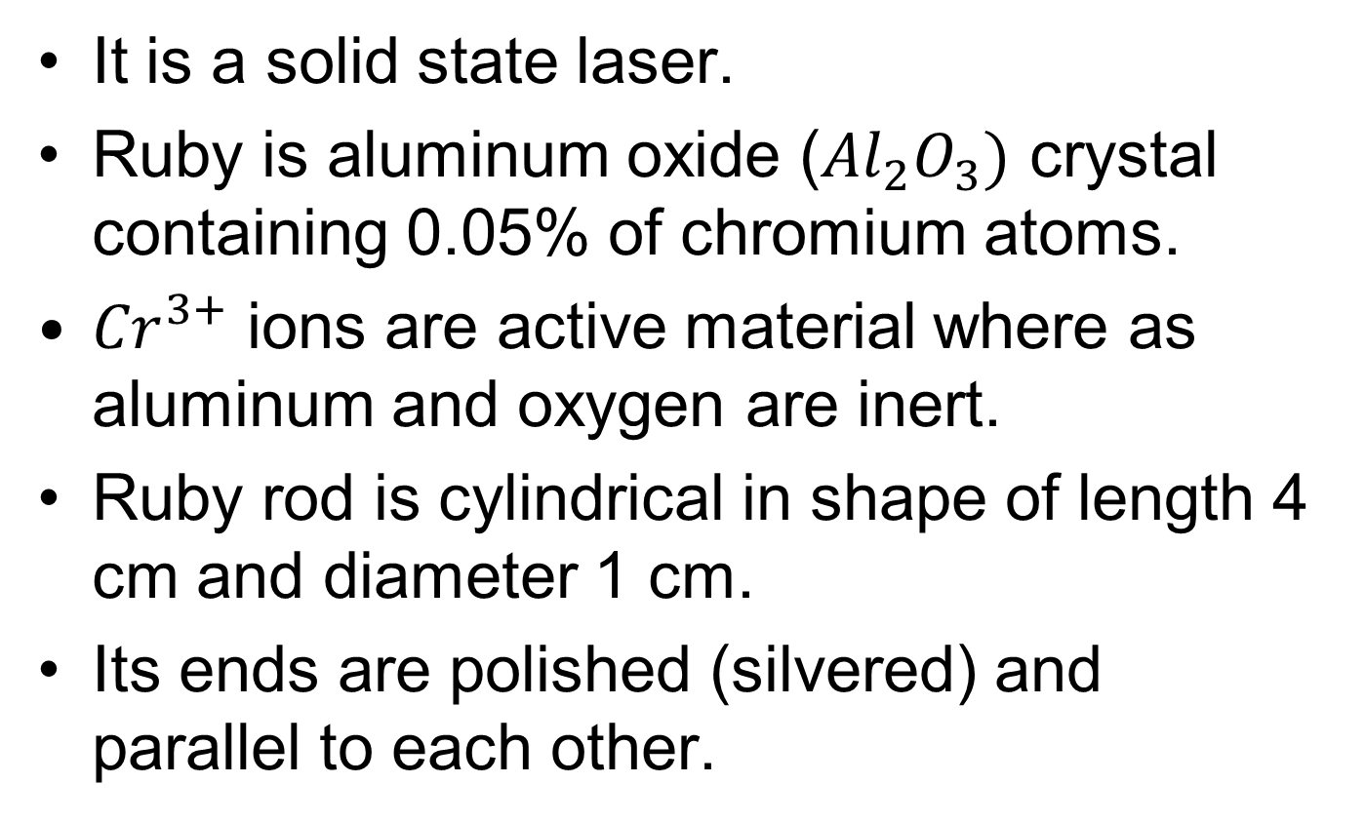
Ruby Laser

Slide 37
Ruby Laser
One end of the rod is fully reflecting and the other end partially reflecting. Ruby rod acts as an optical resonator.
Ruby rod is surrounded by a helical Xenon flash lamp which is used for pumping.

Slide 38
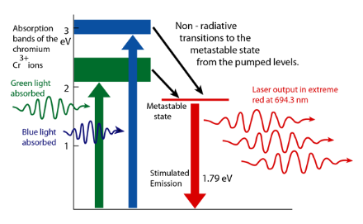
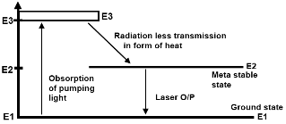
Ruby Laser: energy levels

Slide 39
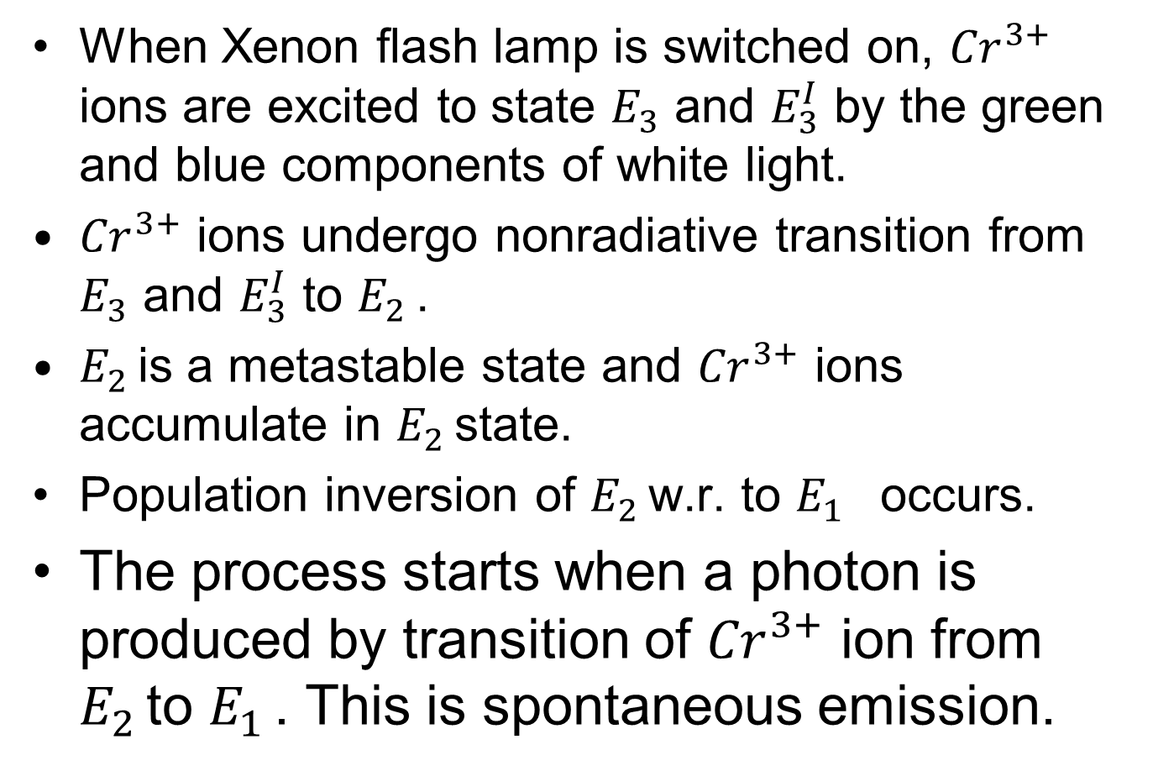
Ruby Laser

Slide 40
Ruby Laser
This spontaneous photon stimulates another excited ion to downward transition.
This process continues and many photons are released.
Red photons of wavelength 6943 Å are given out.
The output is not continues but pulsed.

Slide 41
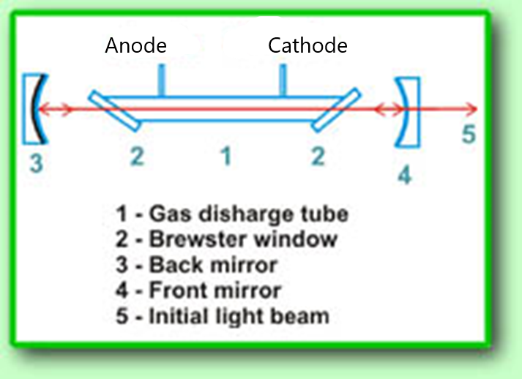
Gas Laser: Helium - Neon

Slide 42
Helium – Neon Laser
In gas lasers such as helium – neon the atoms are characterized by sharp energy levels as compared to those in solids which have broad absorption bands.
Helium – neon laser consists of long discharge tube filled with a mixture of helium and neon gases in the ratio 10 : 1
Electrodes are connected to high voltage source(10 KV).

Slide 43
Helium – Neon Laser
Laser action is due to neon gas. Helium atoms help to excite neon atoms.
The discharge tube contains windows placed at Brewster's angle.
Two mirrors are also present. One mirror is fully reflecting and the other partially reflecting.

Slide 44
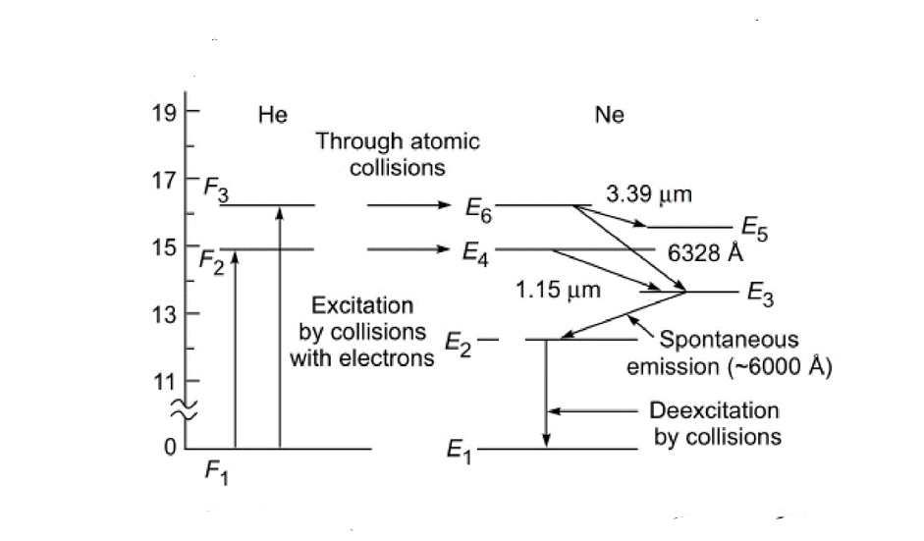
Energy diagram

Slide 45
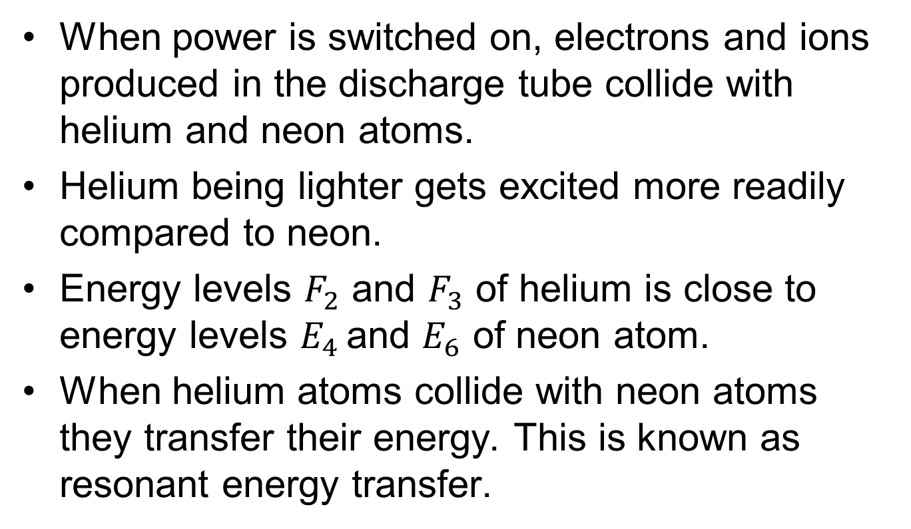
Helium – Neon Laser

Slide 46
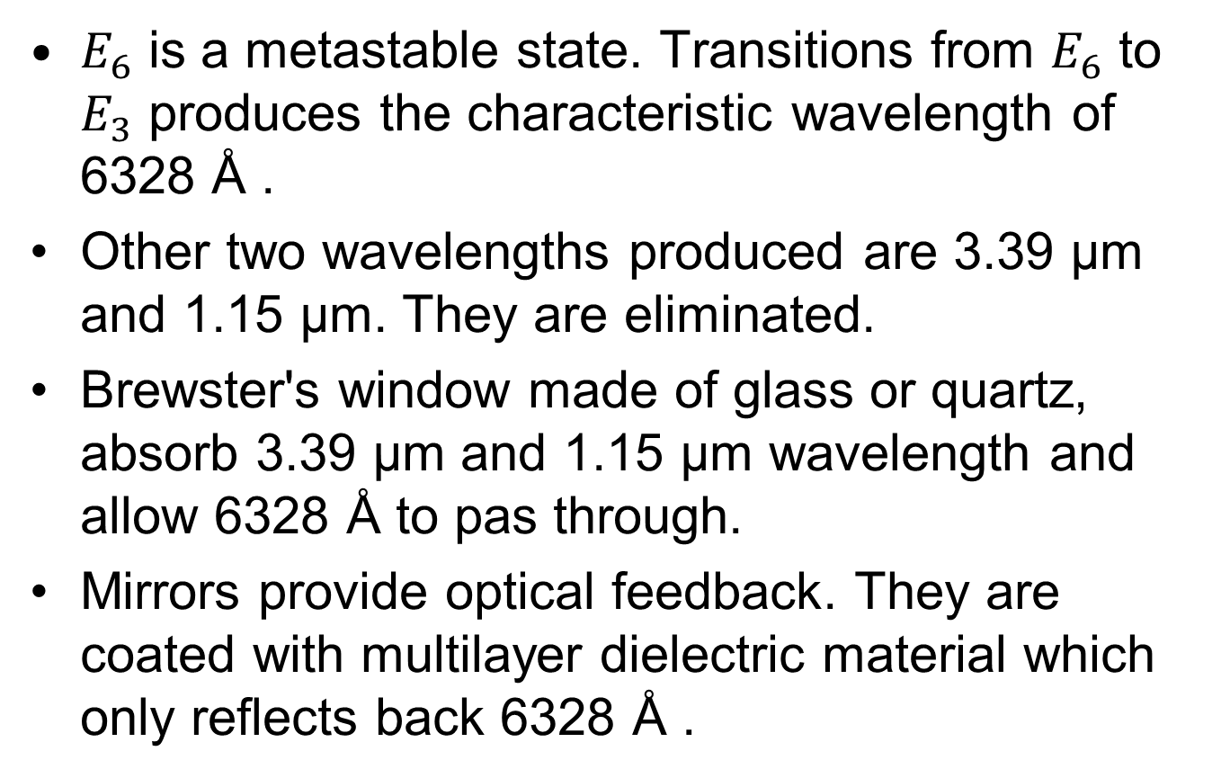
Helium – Neon Laser

Slide 47
Application of Lasers
Ruby Laser: Measurement of distance using pulse echo technique, drilling of high quality holes.
Helium – neon Laser: Metrological application, bar code reading.
Carbon dioxide Laser: Welding, cutting
Argon ion Laser: Welding retinal detachment
Semiconductor Laser: Laser printer

Slide 48
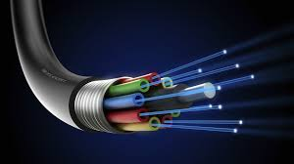
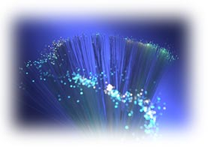
Introduction to Fiber Optics

Slide 49
Fiber Optics
Definition of Optical Fiber:
An optical fiber is a cylindrical wave guide made of transparent dielectric (glass or plastic) which guides light waves along its length by total internal reflection.
Principle: The propagation of light in an optical fiber is based on the principle of total internal reflection.
Conditions for TIR:
Light should be passing from a denser medium to rarer medium.
The angle of incidence in the denser medium should be greater than the critical angle.

Slide 50
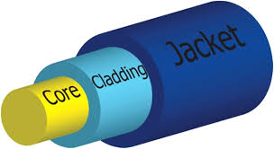
Structure of Optical Fiber
It has three coaxial regions i.e. the core, cladding and outer jacket.
Core: It is the innermost cylindrical region. It is also the light guiding region.
Cladding: The core is surrounded by the cladding.
Outer jacket: It is a plastic coating to protect the cladding.

Slide 51
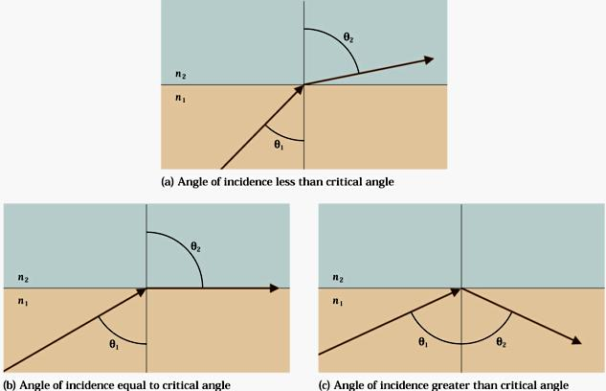
Total internal reflection

Slide 52
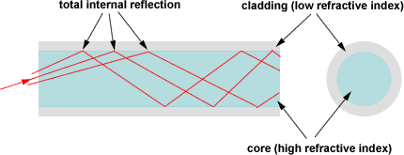
Principle

Slide 53
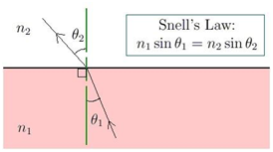
Snell’s Law

Slide 54
Snell's law

Slide 55
Application of Optical Fibers
Optical Fibers have many applications, some of them are:
They are used for illumination and short distance transmission of images.
They are used as wave guides in telecommunications.
They are used in fabricating sensors.

Slide 56
Optical fiber communication system
Fiber optic communication system comprises of:
Transmitter
Receiver
Transmitter consists of light source and input signal modulator.
Receiver consists of optical detector, signal demodulator and output signal display unit such as CRO.
Optical fiber acts as transmission path. It carries the modulated output light signal from the transmitter to the receiver.

Slide 57
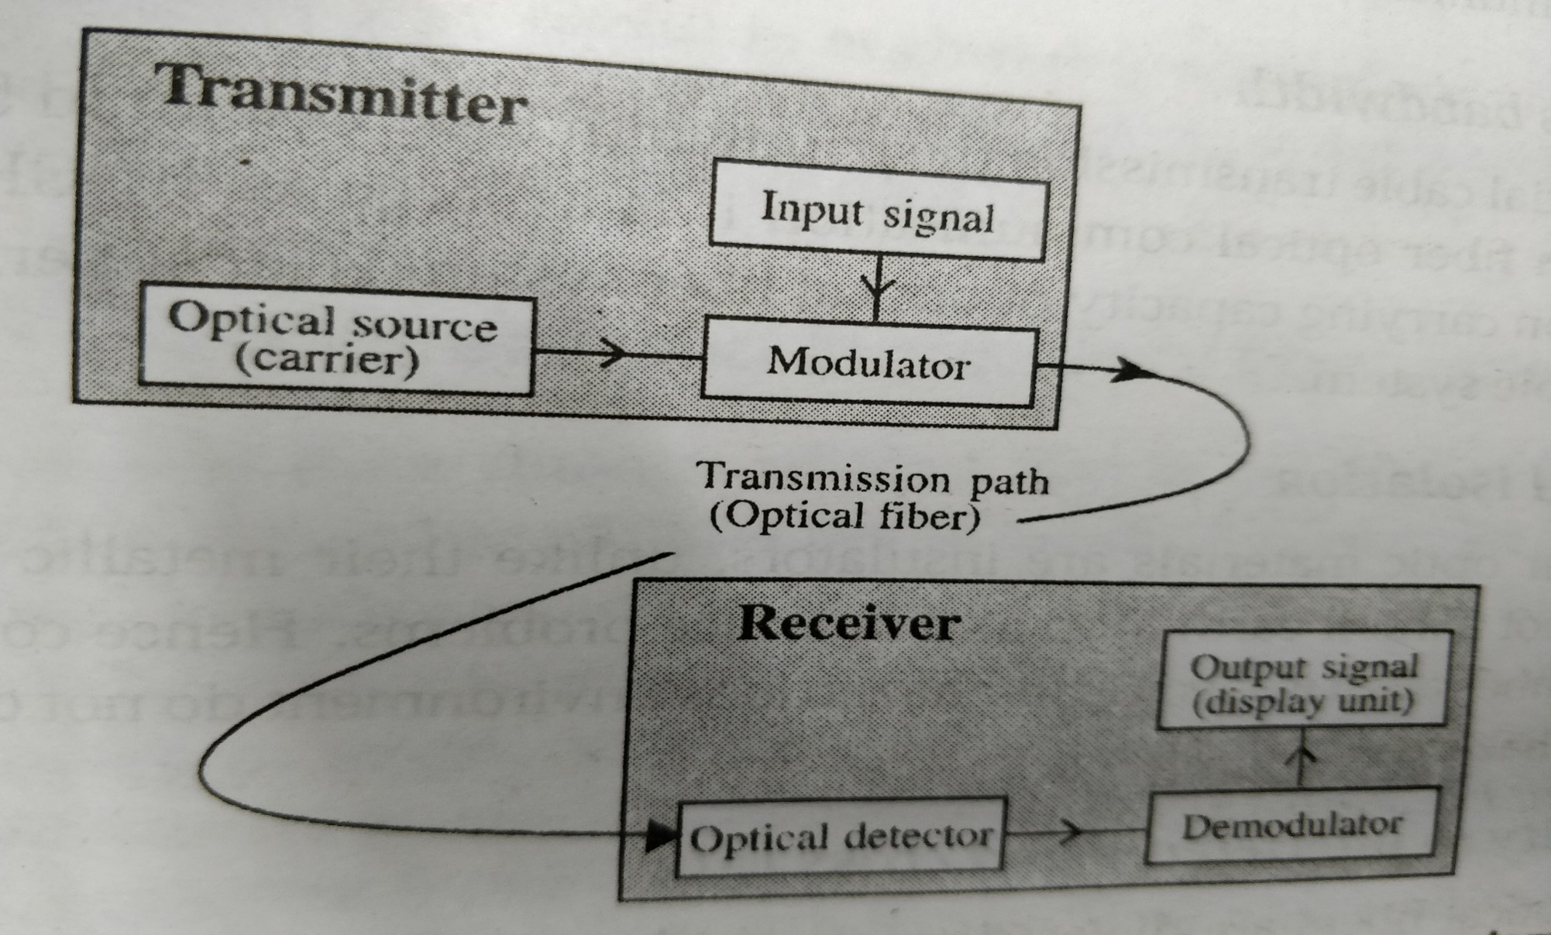
Optical fiber communication system

Slide 58
Optical fiber communication system
Information that is to be transmitted is first converted into an optical signal from an electrical signal
The signal is then modulated using a optical source (carrier) by a modulator. The carrier wave is generated using a LED or Laser diode.
The carrier source output into the fiber is represented by a single pulse.
Optical fiber carriers the pulse.
In the fiber the pulse is attenuated and distorted and hence repeaters are used to regenerate the signal.

Slide 59
Optical fiber communication system
At the receiver the optical signal is converted to electrical signal using a PIN diode.
The signal is then demodulated and the original information is obtained.
Couplers are used to couple the modulated light signal to be transmitted with the fiber.
Connectors are used to increase the length of the fiber.
Repeaters are used to reshape, retime and retransmit the signal.

Slide 60
Comparison of Optical fiber and conventional cables
Large bandwidth: Optical fiber BW = 10¹⁵ GHz, metallic wires = 500 MHz
Electric isolation: Optical fibers are insulators where as metallic wires are conductors. Hence optical fibers can be laid even in electrically hazardous environment.
Optical fibers are immune to EM interference since in optical fibers information is carried by photons which are neutral and cannot be disturbed by high voltage fields.
No cross talk in optical fibers since it works on the principle of total internal reflection.
Small size and weight.
Low transmission loss: The transmission loss per unit length of an optical fiber is about 4 dB/km. Hence for Optical fibers repeaters are spaced at a distance of 100 km where as for copper cables it is at a distance of 2 km.
Low cost: Optical fibers are made of silica which is abundant on earth.

Slide 61
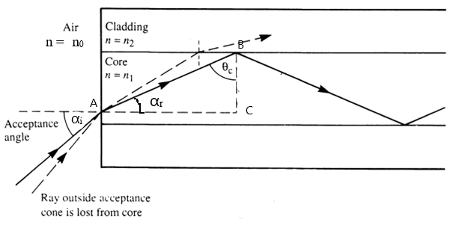
Acceptance angle
Acceptance Angle: The maximum angle of incidence to the axis of optical fiber at which the light ray may enter the fiber so that it can be propagated through TIR.

Slide 62
Acceptance angle
The light is launched from a medium of refractive index n₀ (n₀ = 1 for air) into core of refractive index n_{1.}
The ray enters the fiber from air medium at an angle of incidence of α_{i}
at the point A. The angle of refraction at A is α_{r} .
This ray undergoes total internal reflection at B ( core-cladding interface) at an angle θ. The minimum angle for TIR is θ = θ_{c} (critical angle).

Slide 63
Acceptance angle

Slide 64
Acceptance angle

Slide 65
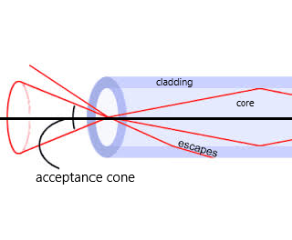
Acceptance angle
This maximum angle is called acceptance angle or acceptance cone half angle.
Light launched at the fiber end within this acceptance cone alone will be accepted and propagated to the other end of the fiber by total internal reflection.

Slide 66
Numerical aperture

Slide 67
Numerical aperture

Slide 68
Types of Optical Fiber
Based on mode of propagation, fibers are classified in to
1. Single mode propagation and 2. Multi mode propagation
Based on variation in the core refractive index (n₁), optical fibers are divided in to two types
1. Step index fiber and 2. Graded index fiber
Based on material, fibers are classified as
1. Plastic and 2. Glass

Slide 69
Types of Optical Fiber
Based on mode of propagation, fibers are classified in to
1. Single mode propagation and 2. Multi mode propagation
Modes: Light launched in to the fiber within the acceptance cone, propagates through it by total internal reflection. But only light which travel through the fiber in a particular direction are allowed, which satisfy the condition of constructive interference. The light rays travelling in these specified directions are called modes.

Slide 70
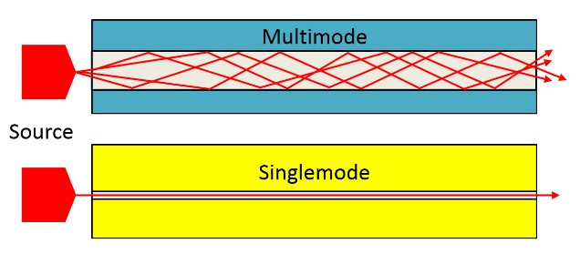
Single mode and Multimode Fiber
If the thickness of the fiber is small that it supports only one mode then the fiber is called monomode or single mode fiber.
If the fiber supports more than one mode then it is called multimode fiber.

Slide 71
Single mode and Multimode Fiber
Single mode
Multimode
Has a small core diameter ( 2 to 8 µm) and can support only one mode of propagation.
Launching of light in to the fiber is difficult.
Fiber can carry information to longer distance since dispersion of signal is less.
Has a large core diameter ( about 50 µm) and can support a number of modes.
Launching of light in to the fiber is easy.
Fiber can carry information to short distance only since dispersion of signal is more.

Slide 72
Step index and Graded index Fiber
Step index fiber
In these fibers the refractive index of core is uniform and is slightly more than that of the cladding.
Intermodal dispersion or pulse broadening occurs.
Graded index fiber
In graded index multimode fiber the refractive index of the core varies radially. It has maximum refractive index at its center which gradually decreases with increase of radius. At the core – cladding interface the refractive index of core and cladding are the same.
Pulse broadening is overcome in graded index fiber.

Slide 73
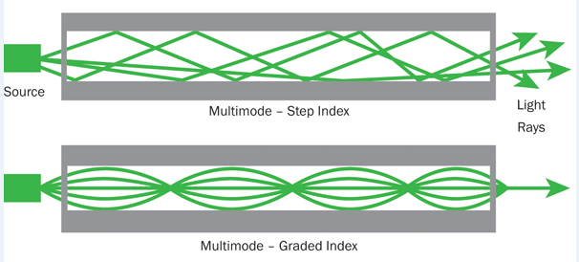
Step index and Graded index Fiber

Slide 74
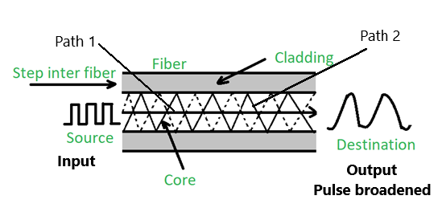
Transmission of signal in step index fiber
Let a pulse travel through the step index multimode fiber.
The pulsed signal travels in different paths( path 1 and path 2).
At the receiving end the ray travelling along path 1 reach first while the ray travelling along path 2 reaches after some time delay.
Hence the pulsed signal received at the destination is broadened and is called intermodal dispersion.
Intermodel dispersion can be overcome by using graded index fiber.

Slide 75
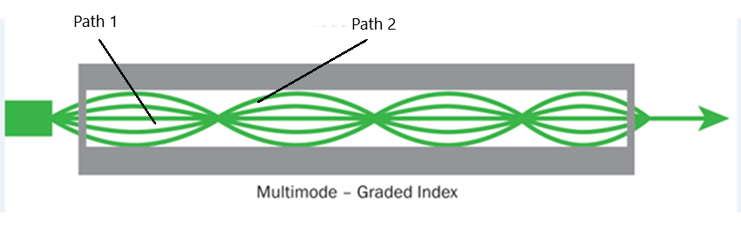
Transmission of signal in graded index fiber
Let a signal pulse travel in two different paths 1 and 2.
The Pulse travelling along path 1, travels less distance but in a medium of higher refractive index.
The pulse travelling along path 2, travels more distance but in a medium of lesser refractive index.
Hence both the pulse reach the destination at the same time and pulse broadening is overcome.

Slide 76
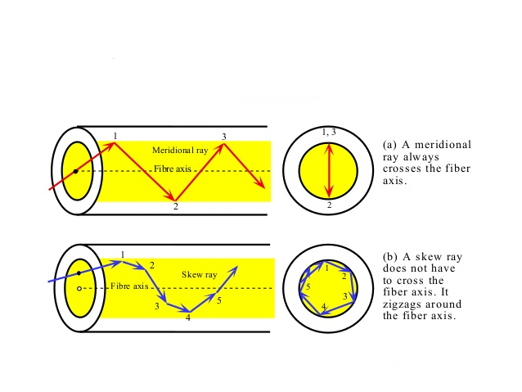
Meridional ray and skew ray
A ray that propagates through the core of a fiber undergoing total internal reflection is called meridional ray. A meridional ray always crosses the fiber axis.
Skew rays describe angular helical path as they travel along the fiber. A skew ray does not cross the fiber axis.

Slide 77
Difference between step index and Graded index fiber
Step Index | Graded Index
1. RI of core is uniform throughout except at one stage. 2. Single & multimode propagations exist. 3. Used for short distance applications. 4. Attenuation losses are of the order 100 dB/km. 5. Meridional rays propagation takes place. 6. Easy to manufacture. | 1. Refractive index varies gradually with radial distance. 2. It is a multi mode fiber. 3. Used for long distance applications. 4. Attenuation losses are of the order 10 dB/km. 5. Skew rays propagation takes place. 6. Difficult to manufacture.

Slide 78
Material of Fiber
Material of fiber: Plastic or glass fiber.
Plastic fiber: Plastic fibers are made either entirely from plastic(core and cladding) or with silica core and plastic cladding.
Full plastic fiber suffer from high attenuation.
Plastic fibers are used for short distance(about 100 m), low bandwidth systems in the wavelength range 600 – 700 mm.
Eg. Polystyrene, it can withstand temperature of about 70⁰ C

Slide 79
Material of Fiber
Glass fibers are made of silica.
They are used for long distance communication and can withstand temperature of about 400⁰ C
Chemical resistance is high in glass fibers
Attenuation is less.

Slide 80
Losses in optical fibers
When light signal propagates through a fiber, it suffers loss of amplitude and change in shape. The loss of amplitude is called as attenuation and the change in shape as distortion.
Attenuation: The loss of optical power as light travels down a fiber is known as attenuation.
Attenuation: It is the ratio of input optical power (P_{i}) in to the fiber to the power of light coming out at the output end (P_{o}).
Attenuation coefficient is given as, α = 10/L log₁₀ P_{i} / P_{o} dB/km.
Attenuation is mainly due to
1. Absorption 2. Scattering 3. Bending

Slide 81
Losses in optical fibers
1. Absorption Losses:
In glass fibers, three different absorptions take place.
Ultra violet absorption: Absorption of UV radiation around 0.14µm results in the ionization of valence electrons.
Infrared absorption: Absorption of IR photons by atoms within the glass molecules causes heating. This produces absorption peak at 8 µm, also minor peaks at 3.2, 3.8 and 4.4 µm.
Ion resonance/OH⁻ absorption: The OH⁻ ions of water, trapped during manufacturing causes absorption at 0.95, 1.25 and 1.39 µm.

Slide 82
Losses in optical fibers
2. Scattering Losses:
The molten glass, when it is converted in to thin fiber under proper tension creates sub microscopic variations in the density of glass. Dopents(used to change the R.I.) cause inhomogeneity to be present and act as scattering centers in the fiber. This leads to losses.
This is also known as Rayleigh scattering and depends on the wavelength of light. Scattering losses are inversely proportional to fourth power of λ.( λ⁴ )
Wavelength below 800 nm have high Rayleigh scattering losses and wavelength above 1700 nm have high losses due to IR absorption.

Slide 83
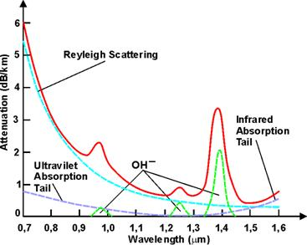
Losses in optical fibers

Slide 84
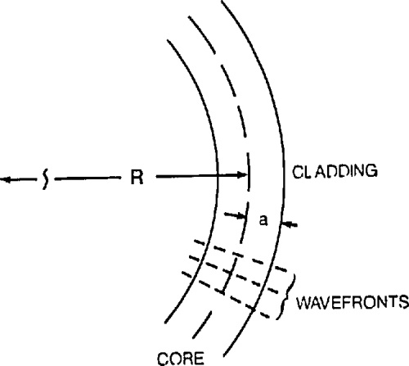
Losses in optical fibers
3. Bending Losses:
Wavefront travels perpendicular to the direction of propagation. For this the part of the mode outside the bend has to travel faster than that on the inside.
But according to Einstein’s theory of relativity, in a single wave front one part should not travel with higher velocity than the other part.
So the part of wave front travelling in cladding medium lost in the form of radiation leads to bending losses.

Slide 85
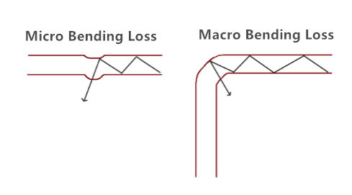
Losses in optical fibers
Micro bend is a small scale distortion. It indicates pressure on the fiber.
Macro bending is a large scale bend. When a fiber is bent through a large angle it undergoes a strain. The bending strain will affect the R.I. and critical angle of the fiber in that area and leads to losses.

Slide 86
Distortion
The light pulse transmitted through a fiber are of a given width, amplitude and interval. These light pulses broaden and spread into a wider time interval because of the different times taken by different rays propagating through the fiber. This phenomenon is known as distortion or pulse dispersion. It is expressed in units of ns/Km.

Slide 87
Numerical

